Slide 1
Simple Exponential Smoothing

Slide 2
Simple exponential smoothing
The exponential smoothing technique is similar to the moving average, but with an important difference.
While the moving average uses the values in the most recent w periods, the simple exponential smoothing takes all the values in the series and computes their weighted average, using weights that decrease exponentially into the past.

Slide 3
Simple exponential smoothing
The concept behind the method is to give more weight (more importance) to the recent values when making forecasts, but without discarding the old values.

Slide 4
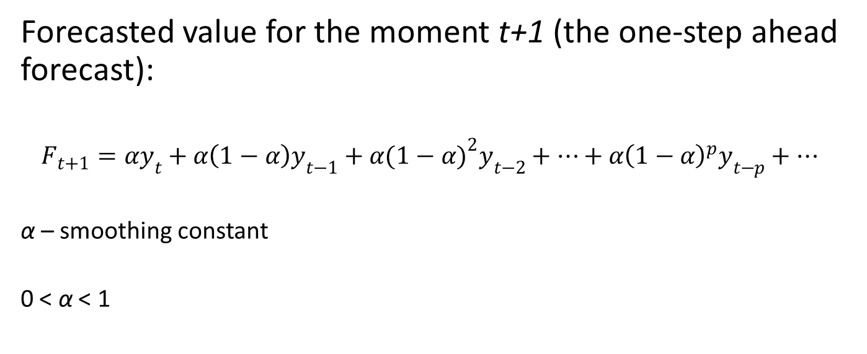
Simple exponential smoothing
Forecasted value for the moment t+1 (the one-step ahead forecast):
$$F_{t+1}=αy_{t}+α\left(1−α\right)y_{t−1}+α{(1−α)}^{2}y_{t−2}+…+α{\left(1−α\right)}^{p}y_{t−p}+…$$
α – smoothing constant
0 < α < 1

Slide 5
Simple exponential smoothing
This method is called “simple” because it has only one smoothing parameter.
There are more advanced exponential smoothing techniques with several parameters.

Slide 6
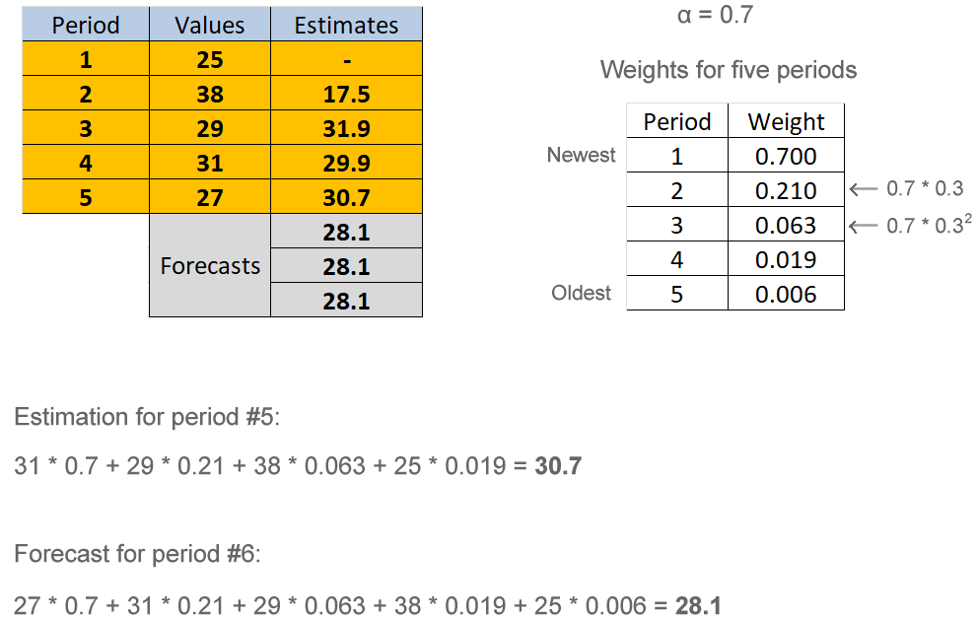
Simple exponential smoothing

Slide 7
Simple exponential smoothing
The value of α determines the learning rate.
if α is big (close to 1), the recent values strongly influence the forecast, while the older values have almost no impact – our model is a fast learner
if α is small (close to 0) the older values have a big influence on the forecast – our model is a slow learner

Slide 8
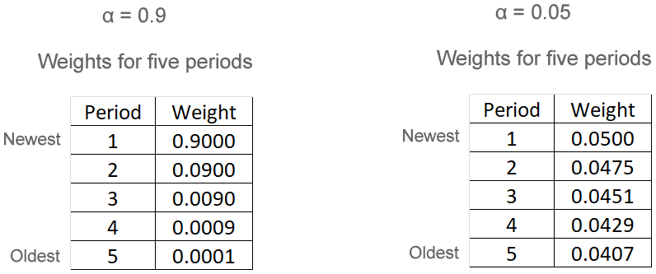
Simple exponential smoothing

Slide 9
Simple exponential smoothing
The best value for α can be obtained through trial and error: try different values and retain the one that ensures the highest prediction accuracy.

Slide 10
Model Implementation

Slide 11
Model implementation
ets() function
ets = error, trend, seasonality
ets(data, α, method)

Slide 12
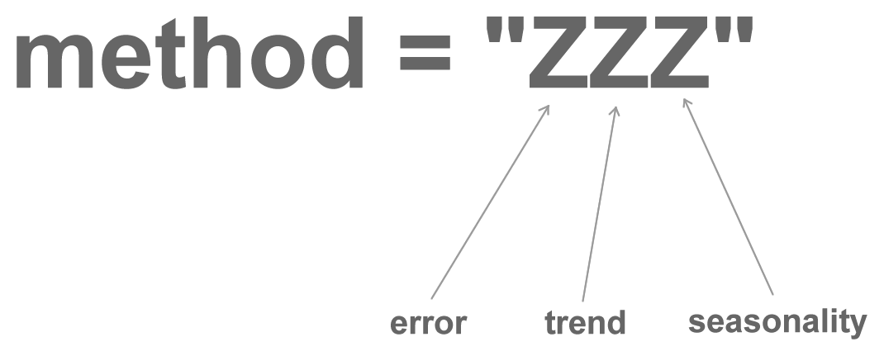
Model implementation

Slide 13
Model implementation
The error component can be of two types:
additive, if the errors remain constant over time
multiplicative, if the errors tend to increase when the series values increase

Slide 14
Model implementation
So the first letter in the method value is:
“A” – if we assume an additive error
“M” – if we assume a multiplicative error

Slide 15
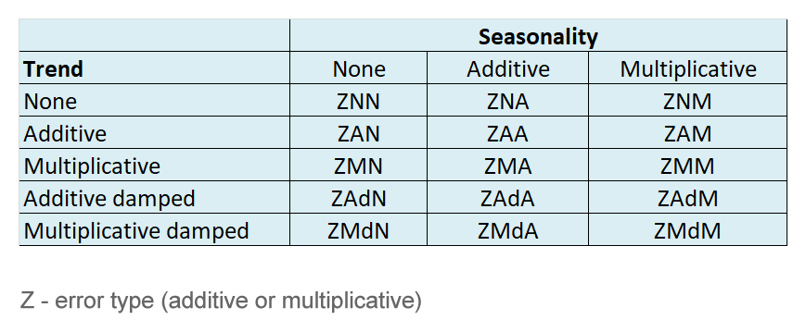
Model implementation
Method values for trend and seasonality

Slide 16
Model implementation
By combining these letters in the method argument, we can build any type of forecasting models. For instance:
“AAN” means a model with additive error, additive trend and no seasonality
“MAA” means a model with multiplicative error, additive trend and additive seasonality
“MAdA” means a model with multiplicative error, additive damped trend and additive seasonality
“MMM” means a model with multiplicative error, multiplicative trend and multiplicative seasonality etc.

Slide 17
Model implementation
What value should we set for the method argument if we build a simple exponential smoothing model?
additive error (A)
no trend (N)
no seasonality (N)
method = “ANN”

Slide 18
Model implementation
If our time series does have trend and seasonality, it may be more logical to assume that errors increase over time, so we could use a model with a multiplicative error.

